Slide 1
Lab 1: Conceptual Design

Slide 2
person
ISA
student
employee
reports
supervised
ISA
academic
non-academic
ISA
administrative
Step 1
technical
staff

Slide 3
equipment
units
hosts
laboratory
attached
faculty
supervised
person
ISA
student
employee
reports
supervised
ISA
academic
non-academic
ISA
administrative
Step 2
technical
staff

Slide 4
equipment
units
hosts
laboratory
attached
organized in
faculty
supervised
role
research
involves
person
project
ISA
student
employee
reports
supervised
ISA
academic
non-academic
ISA
administrative
Step 3
technical
staff

Slide 5
equipment
units
hosts
laboratory
attached
organized in
faculty
supervised
role
research
involves
person
project
ISA
student
employee
reports
funded
ISA
budget
supervised
academic
non-academic
managed
ISA
administrative
Step 4
technical
staff

Slide 6
equipment
model
correspond
equipment
uses
units
hosts
laboratory
attached
organized in
faculty
supervised
role
research
involves
person
project
ISA
student
employee
reports
funded
ISA
budget
supervised
academic
non-academic
managed
ISA
administrative
Step 5
technical
staff

Slide 7
equipment
requires
certification
model
correspond
holds
equipment
uses
units
hosts
laboratory
attached
organized in
faculty
supervised
role
research
involves
person
project
ISA
student
employee
reports
funded
ISA
budget
supervised
academic
non-academic
managed
ISA
administrative
Step 6
technical
staff

Slide 8
equipment
requires
certification
model
correspond
holds
reserves
equipment
uses
units
hosts
laboratory
attached
organized in
faculty
supervised
role
reservation
booked for
research
involves
person
project
makes
ISA
approves
student
employee
reports
funded
ISA
budget
supervised
academic
non-academic
managed
ISA
administrative
Step 7
technical
staff

Slide 9
has
maintenance
operations
equipment
requires
certification
model
correspond
holds
reserves
equipment
uses
units
hosts
laboratory
attached
organized in
faculty
supervised
role
reservation
booked for
research
involves
person
project
makes
ISA
approves
student
employee
reports
funded
ISA
carried out
budget
supervised
academic
non-academic
managed
ISA
administrative
Step 8
technical
staff

Slide 10
has
calibration
operation
has
maintenance
operations
equipment
requires
certification
model
correspond
holds
reserves
equipment
uses
units
hosts
laboratory
attached
organized in
faculty
supervised
role
reservation
booked for
research
involves
person
project
makes
ISA
approves
student
employee
reports
funded
ISA
carried out
budget
supervised
academic
non-academic
managed
ISA
administrative
Step 9
technical
staff

Slide 11
has
calibration
operation
has
maintenance
operations
equipment
requires
certification
model
correspond
holds
reserves
equipment
uses
units
hosts
last re-stock
date
available
storage
quantity
condition
consumable
stock
laboratory
attached
unit price
supplies
supplier
consumed
organized in
faculty
supervised
role
quantity used
reservation
booked for
research
involves
person
project
makes
ISA
approves
student
employee
reports
funded
ISA
carried out
budget
supervised
academic
non-academic
managed
ISA
administrative
Step 10
start date
monitored
technical
staff

Slide 12
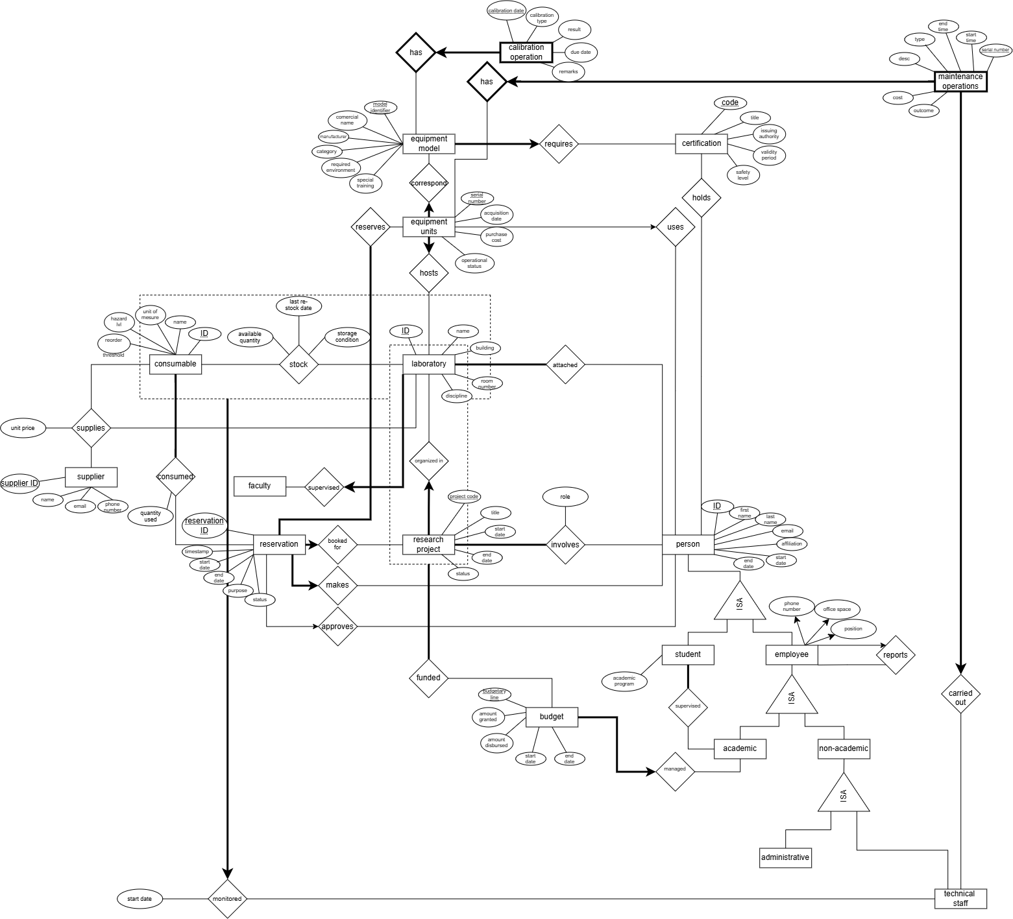
Step 11

